Slide 1





Next Gen Employability Program
NEXT GEN EMPLOYABILITY PROGRAM
Creating a future-ready workforce
Student Details:
College Name:
Student Name :Mohammed Sauban Samith P
Student ID :au513521104026
Annai Mira College Of Engineering And Technology
Notes:
1

Slide 2

Next Gen Employability Program
CAPSTONE PROJECT SHOWCASE
Project Title
Building Bus Reservation System using Python and Django
Abstract | Problem Statement | Project Overview | Proposed Solution | Technology Used | Modelling & Results | Conclusion

Slide 3
Next Gen Employability Program
Abstract:
The Bus Reservation System (BRS) is an essential component in the modern transportation industry, streamlining the process of booking and managing bus tickets for passengers. This project focuses on the development of a robust BRS using Django, a high-level Python web framework, to provide a user-friendly and efficient platform for both customers and administrators.
In the Bus Reservation System we have used a database to store the bus details in the Django administration and according to the list of bus details we can book a bus ticket by giving the source and destination address in the webpage.
The architecture of the BRS will be designed to handle concurrent user requests efficiently, ensuring a seamless experience even during peak booking times. Integration with payment gateways will enable secure online transactions, enhancing convenience for users.
The development process will follow agile methodologies, allowing for iterative improvements based on user feedback and changing requirements. Testing will be conducted rigorously to ensure the reliability and stability of the system across different environments and usage scenarios.
Source :

Slide 4
Next Gen Employability Program
Problem Statement:
The current bus reservation process suffers from several inefficiencies and pain points, including:
Manual Booking Processes: Many bus operators still rely on manual booking processes, leading to errors, delays, and inefficiencies in ticket issuance and reservation management.
Limited Accessibility: Customers face difficulties in accessing booking facilities, particularly in remote areas where online booking options may be limited or unavailable.
Lack of Real-Time Information: Passengers often lack real-time information on seat availability, bus schedules, and ticket prices, leading to uncertainty and inconvenience during the booking process.
Security Concerns: Existing systems may lack robust security measures, making them vulnerable to data breaches, fraudulent activities, and unauthorized access to sensitive passenger information.
Scalability Challenges: Traditional systems may struggle to handle increasing demand during peak travel seasons, leading to system crashes, slow response times, and degraded user experience.
Source :

Slide 5
Next Gen Employability Program
Project Overview:
1.Objective of the Study: The primary goal is to design and implement a ticketing system that enhances the booking experience for bus travelers by offering online ticket reservations, checking ticket availability, and facilitating secure online payments.
2.Scope of the Study: The system's scope includes functions such as acquiring tickets, knowing the next available bus, and assigning drivers to specific vehicles, all of which are traditionally done manually using conductors.
3. Significance of the Study: The study is expected to benefit bus terminals and policymakers by providing insights on how to enhance electronic bus ticketing systems and create a user-friendly environment for both staff and customers.It aims to address the challenges faced by customers in accessing bus tickets manually and improve the overall ticketing process by introducing online booking and payment options.
4.Implementation: The system is designed to manage and compile a traditional database, handle ticket bookings, track buses, and manage departures effectively.It utilizes PHP for software terminals and MySQL for the backend to improve customer support, enhance relationships, and optimize the performance of the bus reservation system.
Source :

Slide 6
Next Gen Employability Program
Proposed Solution:
To create a bus reservation system using Django and Python, you can start by exploring existing projects that use Python for ticket booking or reservation systems. For instance, there are projects on GitHub that provide a role-based web application for bus booking, which automates the booking process and offers a user-friendly interface for customers to reserve seats.
To ensure the quality of your bus reservation system, you can consider implementing a triaging system for managing and reviewing tickets, similar to the one used in Django.
This system allows you to categorize, prioritize, and manage tickets efficiently, ensuring that issues are addressed promptly and features are implemented according to the community's needs.
Source : https://docs.djangoproject.com/en/dev/internals/contributing/triaging-tickets

Slide 7
Next Gen Employability Program
Additionally, you can explore existing reservation systems built using Django and Python, such as the TUM library reservation system, which automates the reservation process and uses web scraping and Selenium for Python.
These projects can serve as a starting point for your bus reservation system, providing you with a foundation to build upon and adapt to your specific needs.
To create a bus reservation system using Django and Python, you can include:
1. Explore existing ticket booking or reservation systems built using Python.
2. Implement a triaging system for managing and reviewing tickets.
3. Use tools like CodeProject.AI to streamline the development process.
4. Explore existing reservation systems built using Django and Python for inspiration and guidance.
Source :https://github.com/topics/ticket-booking-system?l=python

Slide 8


Next Gen Employability Program
Technology Used
Front-end
Back-end
Source :

Slide 9
Next Gen Employability Program
Modelling & Results
To model a bus reservation system, you can follow the approach outlined in the study "An Extension to UML for the Modeling of Web Based Bus Reservation System“.
The proposed extension to UML covers aspects of use case diagram, sequence diagram, and class diagram for the modeling of a web-based bus reservation system.
For the use case diagram, you can define the actors and use cases for the bus reservation system, such as the customer, bus operator, and administrator. The customer can book a ticket, view available buses, and cancel a ticket, while the bus operator can add or remove buses, update schedules, and manage seat availability.
The administrator can manage user accounts, view reports, and perform system maintenance. For the sequence diagram, you can define the interaction between the actors and the system for each use case.
For example, for the "book a ticket" use case, the customer selects a bus, chooses a seat, enters passenger information, and pays for the ticket. The system then confirms the reservation and updates the seat availability.
In summary, to model a bus reservation system, you can use UML extensions for web-based bus reservation systems, sequence diagrams for interaction design, class diagrams for object-oriented design, and ERDs for database design
Source :

Slide 10
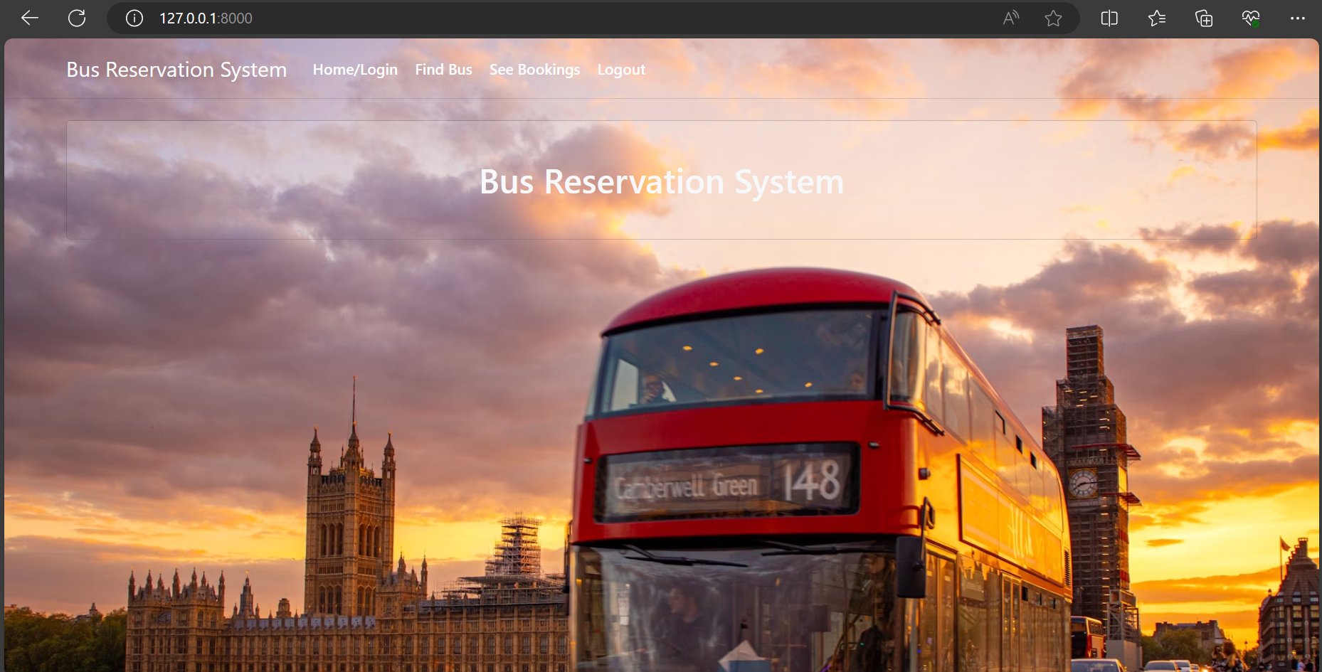
Next Gen Employability Program
Homepage
"Book your next journey hassle-free with our intuitive bus reservation system. Discover convenience and reliability at your fingertips."

Slide 11
Next Gen Employability Program
About-Us-Page
1.System Features: Highlight the key features of the bus reservation system, such as online ticket booking, trip and fleet administration, agent management, driver evaluation, and client satisfaction monitoring. Emphasize the system's ability to store personal data records, scheduled routes, frequent trips, drop places, and other essential information for clients, along with real-time seat availability, multiple payment methods, and seat map capabilities.
2.Benefits: Communicate the benefits of using the bus reservation system, including improved work efficiency, security, accuracy, dependability, and practicality .Mention how the system reduces human factor risks, increases conversion rates, and enhances the overall booking experience for customers.
3. Company Information: Provide details about the company developing the bus reservation system, highlighting its expertise in travel technology solutions and its commitment to offering a responsive and user-friendly booking system for travel management companies, agencies, and tour operators worldwide. Mention the company's focus on automating bus bookings and payments for various routes, managing bus inventory, fares, timetables, accounting, and reporting to streamline operations and enhance customer service.

Slide 12
Next Gen Employability Program
Service-Page
A service page for a Bus Reservation System should provide information on the features and benefits of the system for both customers and bus operators. It should highlight the convenience and efficiency of online ticket booking, real-time seat availability, multiple payment methods, and seat map capabilities.
The service page should also emphasize the importance of an online bus reservation system in improving work efficiency, security, accuracy, dependability, and practicality.
The service page can also include information on the system's capabilities for trip and fleet administration, agent management, driver evaluation, and client satisfaction monitoring.
It can also mention the system's compatibility with various devices and platforms, such as desktop, laptop, and mobile devices, and the availability of a responsive mobile app.Additionally, the service page can provide information on the system's integration with external systems, such as fleet ERP, registers, social media, and third-party resellers, through well-structured and documented APIs.
It can also mention the system's ability to provide real-time information about the passenger's journey, such as the bus's current location, warnings when the vehicle deviates from the scheduled route, roadwork, and any operating changes, through a website or a mobile app.

Slide 13
Next Gen Employability Program
Departments-Page
The Department Page for a Bus Reservation System typically serves as a central hub where users can access various functionalities related to the system. In the context of the provided sources, the Department Page may include essential features such as:
1. Home Page: The main landing page of the system where users can navigate to different sections like booking tickets, viewing bus schedules, and accessing customer support.
2. Customer Booking: A dedicated page where customers can search for buses, select seats, enter passenger details, and complete the booking process.
3. Bus Management: Functionality for bus operators to add or remove buses, update schedules, manage seat availability, and monitor bus-related information.
4. User Account Management: Tools for administrators to manage user accounts, view reports, perform system maintenance, and ensure smooth operation of the reservation system.
5. Ticketing System: Integration of a ticketing system that allows users to book tickets for various routes and destinations, view ticket details, and receive booking confirmations.
In summary, the Department Page for a Bus Reservation System acts as a central interface where users, operators, and administrators can access key functionalities such as booking, bus management, user account management, ticketing, reporting, and ticket triaging.

Slide 14
Next Gen Employability Program
Blog-Page
In the modern world, where time is of the essence, efficient travel planning is crucial. From daily commutes to weekend getaways, having a reliable transportation system is essential for a seamless journey. Our bus reservation system offers a solution to simplify the process, ensuring convenience and peace of mind for travelers.
Gone are the days of waiting in long lines or making phone calls to book a bus ticket. Our online platform provides easy access to a wide range of routes, schedules, and ticket prices. With just a few clicks, travelers can compare options and secure their seats, all from the comfort of their own home or office.
At Bus Reservation System , we're committed to simplifying the travel experience for our customers. Whether you're a frequent commuter or an occasional traveler, our system is designed to streamline the booking process and ensure a smooth journey from start to finish. Discover the convenience and reliability of our services today, and let us help you reach your destination with ease.

Slide 15
Next Gen Employability Program
Future Enhancements:
Future enhancements for a Bus Reservation System can include:
Advanced Inventory Control: Implementing real-time inventory management to maximize seat utilization and revenue per kilometer, allowing passengers to choose their favorite seats on all stop segments without affecting availability on other segments.
Comprehensive and Well-Documented APIs for Integration: Developing a well-structured database schema and service-oriented architecture, with a well-documented API for integration with external systems, such as fleet ERP, registers, social media, and third-party resellers.
On-Board Registration: Enabling electronic tickets with as little pre-purchase time as possible, allowing passengers to purchase tickets with a numbered seat on their smartphone, and providing drivers with a continuous, real-time picture of their constantly changing passenger manifest.
Capability of Self-Service: Offering self-service function for passengers to manage travel-related aspects, such as booking, cancellation, and modification, with a user-friendly interface that is simple, logical, and intuitive.
Passenger Information in Real-Time: Providing real-time information about the passenger's journey, such as the bus's current location, warnings when the vehicle deviates from the scheduled route, roadwork, and any operating changes, through a website or a mobile app.
Integration of Digital Marketing Tools: Utilizing the reservation system as a source of data for marketing purposes, implementing social media, campaigns, email marketing, loyalty programs, and other tools to attract millennials and boost ridership

Slide 16
Next Gen Employability Program
Conclusion
The conclusion for a Bus Reservation System can be summarized as follows:
1. Efficiency: A Bus Reservation System streamlines the ticket booking process, reducing the need for manual operations and minimizing errors. It provides real-time updates on seat availability, pricing, and other reservation-related information, making it easier for both customers and staff to manage bookings.
2. Accessibility: An online Bus Reservation System enables customers to book tickets 24/7 from anywhere, eliminating the need to physically visit a ticket counter and wait in long queues. This convenience can significantly boost sales and improve customer satisfaction.
3. Data Organization: A Bus Ticketing System provides an organized dashboard for managing data, allowing companies to store and retrieve information easily.This feature can help optimize work performance, reduce mistakes, and earn audience trust through review features.
4. Market Growth: The market for online bus ticketing systems is projected to grow significantly, with a CAGR of 14.9% from 2022 to 2030. Leading players in the industry continue to innovate, providing enhanced features and a seamless booking experience for users.
5. Mobile App Demand: The demand for mobile apps that facilitate bus ticket bookings has surged, leading to the emergence of numerous bus ticketing app development companies. These apps offer a convenient and efficient online platform for bus reservations, further enhancing the user experience.
Source :

Slide 17
Next Gen Employability Program
Thank You!
Notes:
Thank You !!

